Slide 1
Impact of Multi-View Fusion and Biomechanical Modeling on Markerless Motion Tracking
Review – 20/11/2025

Slide 2

Key Hypotheses
1 - Impact of biomechanical modelisation | 2 - Multi-view vs Single-view
Biomechanical model ➔ = Hard joint constraints
13 single-view methods
2 multi-view methods
SMPL model (Skinned Multi-Person Linear model)
= Soft joint constraints
OpenCap
( ≈ MOCAPIA)
Theida 3D
SMPL model
VS
SMPL model + OpenSim
Only on single-view methods !!
What gains justify switching technology?

Slide 3
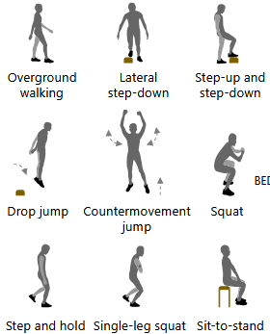
Single-View methods
- All of them are based the SMPL model
DATA process
23 participants – controlled indoor environments
Markerless Solution
20 RGB cameras 100Hz Calibration board
Use a static pose to prevent a discrepancy between physical and virtual markers
Marker Solution (reference)
20 IR cameras 100Hz 45 physical markers A wand calibration
Multi-View methods
OpenCap | Theida 3D
No SMPL model But a IK correction with OpenSim

Slide 4
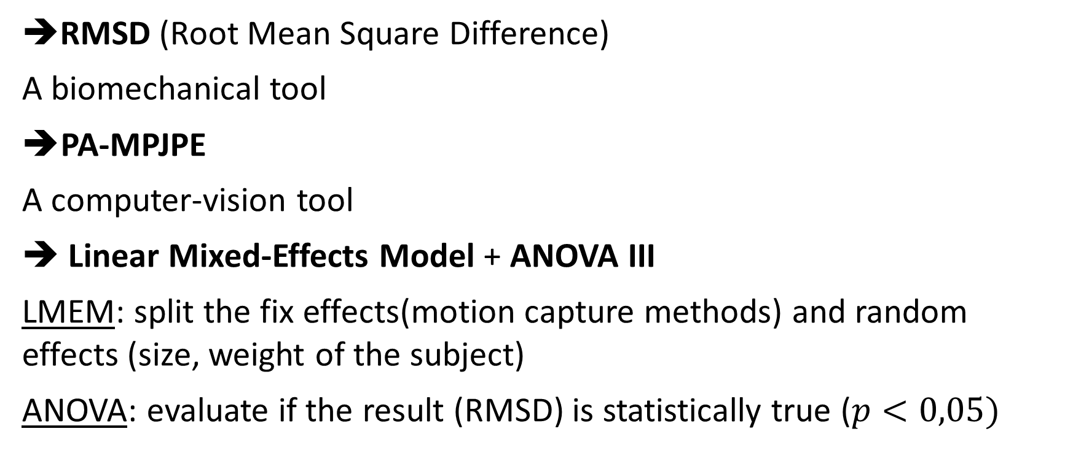
Tools of evaluation
RMSD (Root Mean Square Difference)
A biomechanical tool
➔PA-MPJPE
A computer-vision tool
Linear Mixed-Effects Model + ANOVA III
LMEM: split the fix effects(motion capture methods) and random effects (size, weight of the subject)
ANOVA: evaluate if the result (RMSD) is statistically true ($p<0,05)$

Slide 5
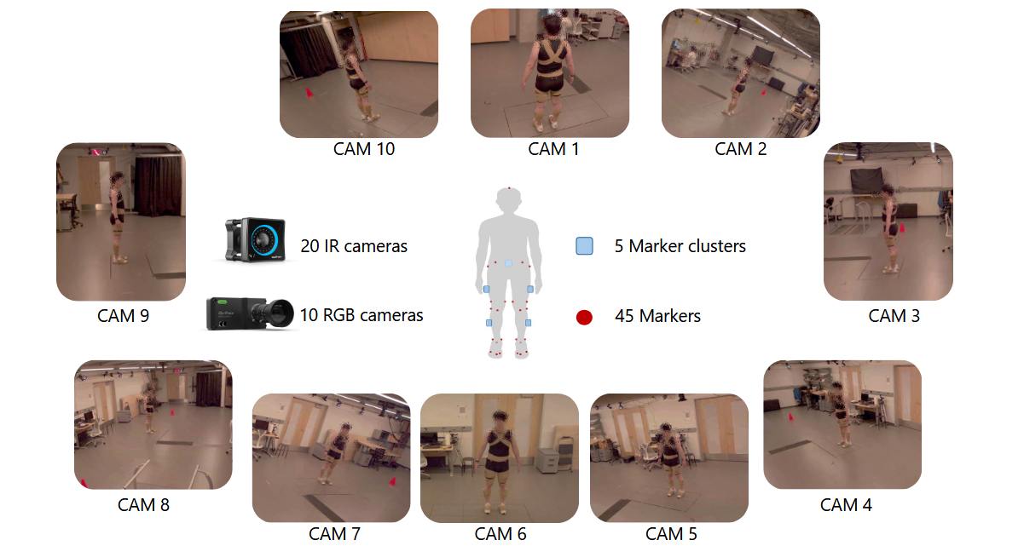
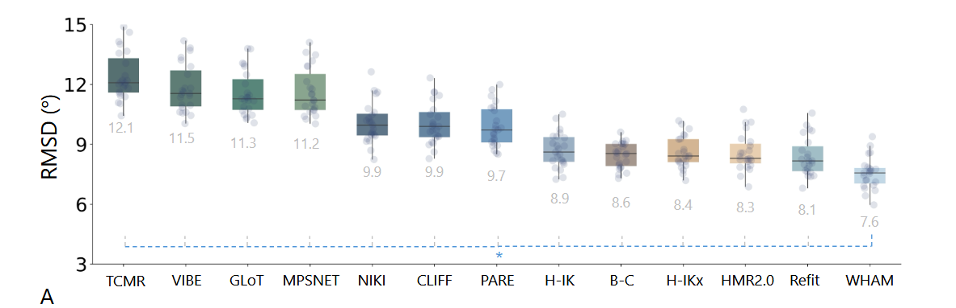
Process 2/4 – Primary evaluation
Evaluation of 13 single view methods
Evaluated across all 10 cameras – 33Hz (same as us) Average RMSD across all views after a Kruskal-Wallis test WHAM achieved the lowest RMSD with 7.6°

Slide 6
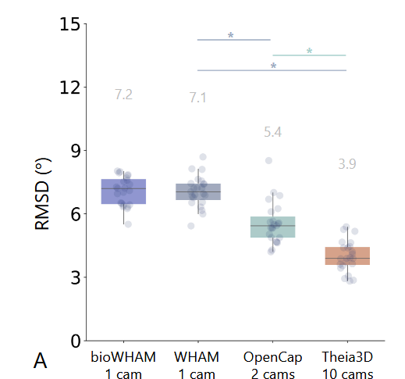
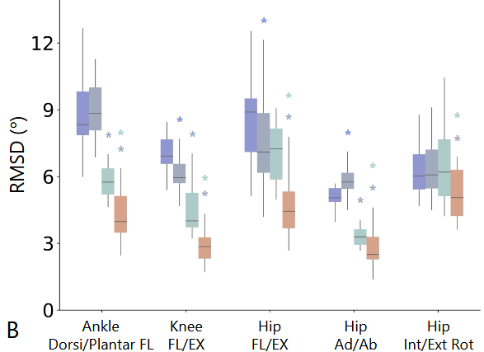
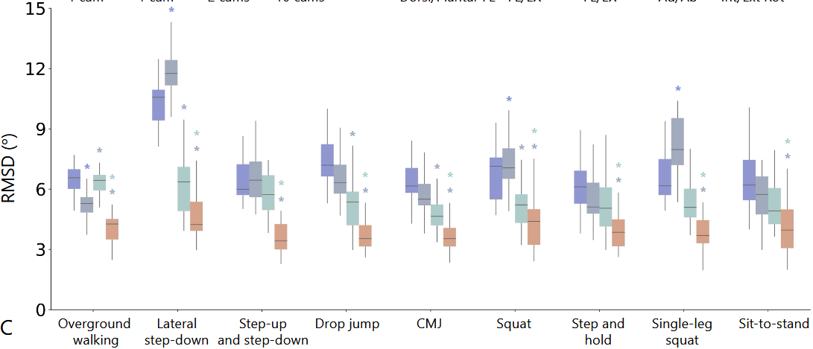
Results- hypothese 1
WHAM model
(camera 7)
Use of the SMPL model on WHAM
WHAM with «soft» constraints
Use of the SMPL model on WHAM
29 markers used for
OpenSim IK
WHAM model
(camera 7)
bioWHAM

Slide 7
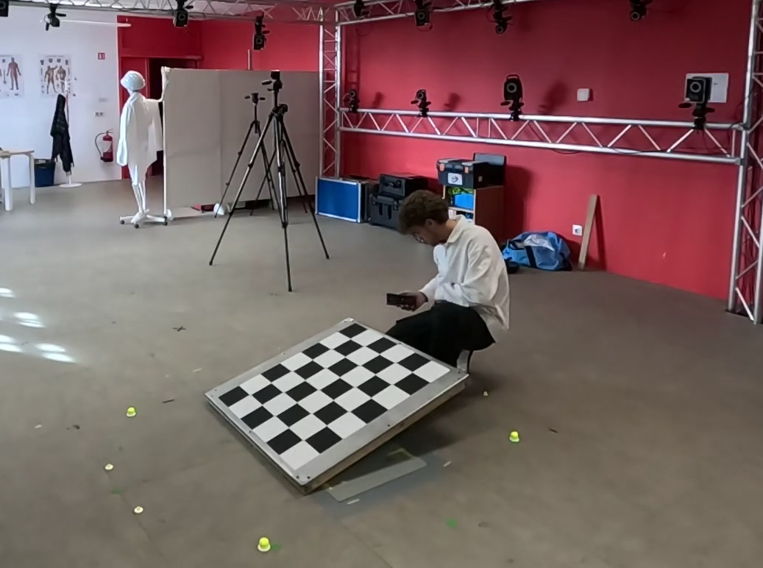
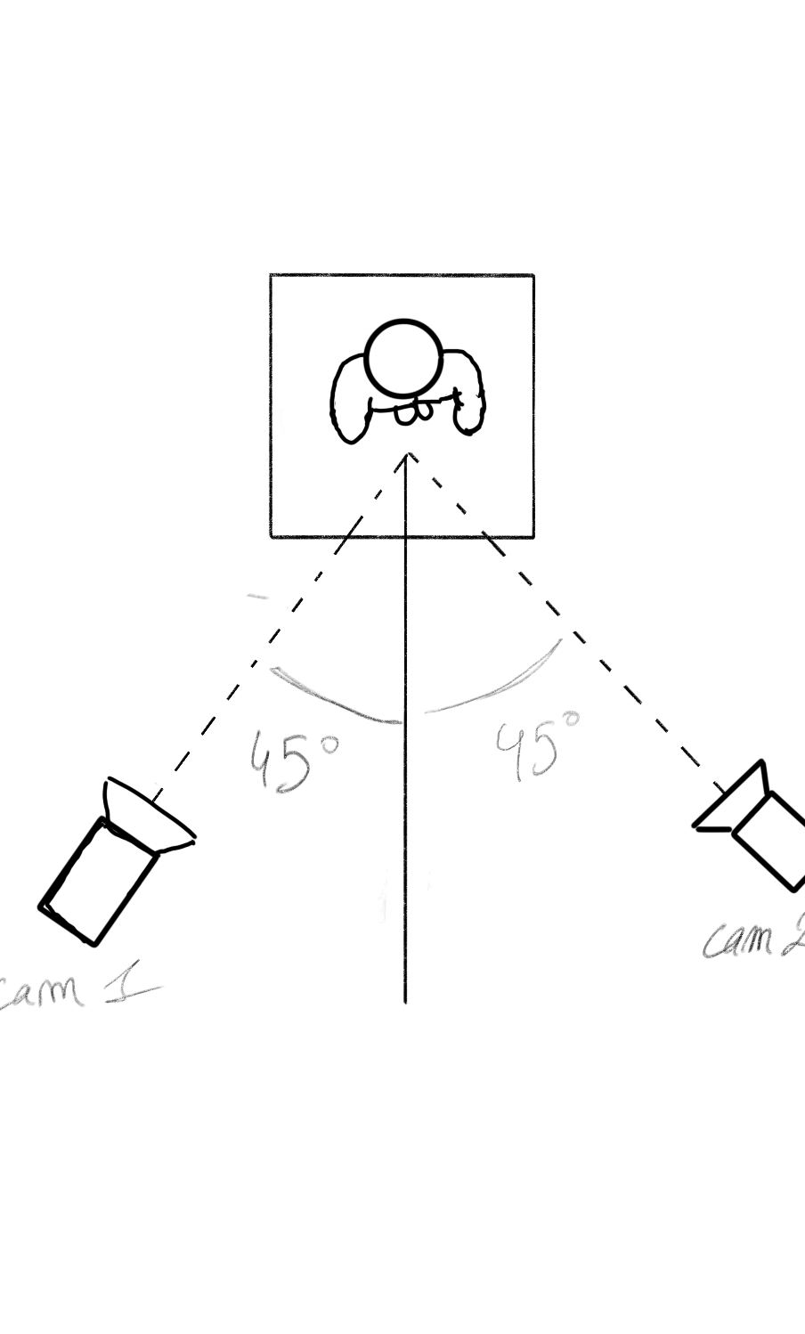
Process 4/4 – Hypothese 2
OpenCap
Calibration
2 cameras
Estimateur de pose 2D
HRNet | OpenPose
Considered less accurate than RTMPose (used in MoCapIA)
90°
triangulation
filtering
The same calibration is used for OpenCap et Theia3D – no reprojection error study
Marker Augmentation
IK on OpenSim
No accuracy gains by adding cameras

Slide 8
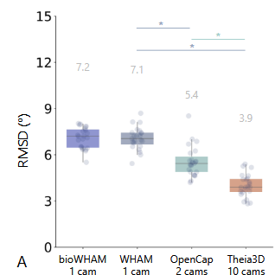
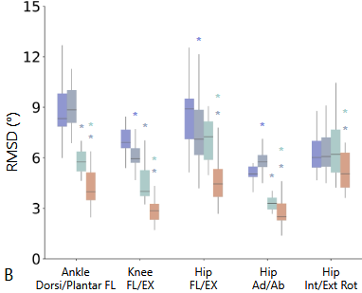
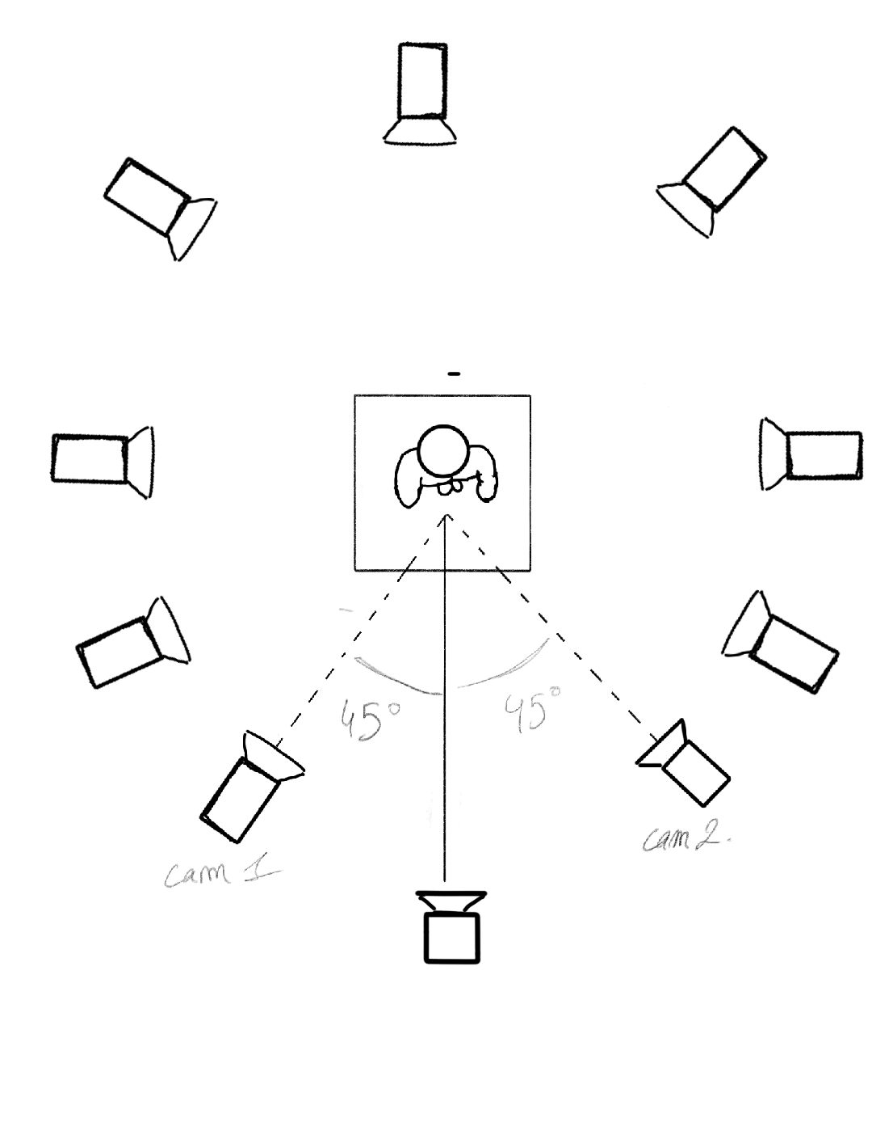
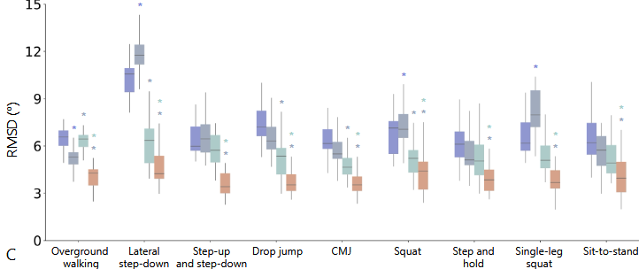
Results– Hypothese 2
Theia3D
10 cameras – 6 cameras min
Black-Box
(private licence)
WHAM/bioWHAM
OpenCap

Slide 9
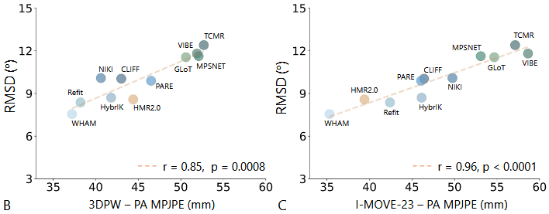
Auxiliary Finding
Datasets
3DPW | I-MOVE-23
Standart reference dataset in CV | data collected for this study
Correlation between RMSD and PA-MPJPE
An metric used in the field of biomechanic
An metric used in the field of computer vision
Conclusion
Both metrics are highly correlated
Both of them could be used in MoCapIA’s project

